Slide 1
DS Growth Case Study
Bijan Seyednasrollah Nov 2020

Slide 2
Table of content
Problem Statement
Workflow
Preprocessing
Processing
Post-processing
Engineering Architecture and Trade-Offs:
Business Performance and ROI

Slide 3
Problem Statement
We want to predict the probability of “activation” based on the following data per click using data from Google Adwords.
1. created_date - date on which the click was recorded
2. location_in_query - city name that appeared in search query
3. platform - platform such as web/mobile
4. campaign_state - US state where the ad campaign was run
5. in_city - whether the ad campaign was run in a city or not
6. is_prime - whether the word fico prime appeared in the search query
7. is_hardship - whether the word hardship appeared in the search query
8. category_debt_type - type of debt solution that appeared in the search query
9. is_activated[TARGET] – whether the user talked to FFN call center or not

Slide 4
I developed the workflow in TensorFlow, summarized below.
Raw data
Preprocessing
Cleaned and organized data
Model-ready data
Model
Evaluation
Processing
Model Tuning
Test
Post-processing
Post-processing
Interpretation

Slide 5
Preprocessing
There are several challenges regarding the dataset that should be properly addressed before feeding it into the model:
Missing data
Imbalanced classes
Incorporating date and time
Multi data types and hyper-categorical data
We address each challenge by performing several steps as follows

Slide 6
Preprocessing- Missing Data (Imputation)
The table below shows number of missing values for each variable:
created_date 0
location_in_query 15
platform 0
campaign_state 6
in_city 0
is_prime 0
is_hardship 0
is_activated 0
category_debt_type 9859
time_index 0
Several columns contain missing data points that should be imputed, including: location_in_query, campaign_state, category_debt_type.
For the most part, I used majority voting to impute missing values for the above columns. I also replaced invalid state name with ‘fl’ which was the majority class. The missing location_in_query were replaced by ‘unknown_location’

Slide 7
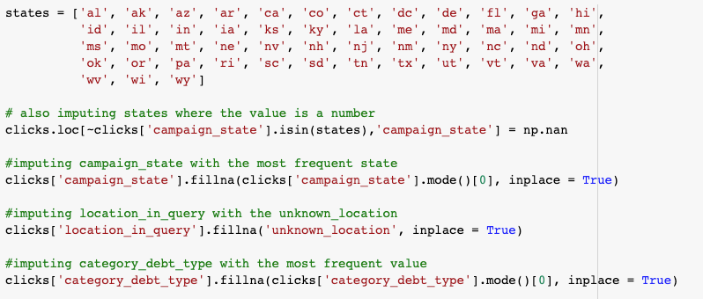
Preprocessing- Imputation (Code)

Slide 8
Preprocessing- Imbalanced Classes
The label data is highly imbalanced:
87407 as is_activated=1
6787 a is_activcated=0
This could be a major problem if properly not resolved. There are several ways to tackle this issue: oversampling the minority class, under-sampling the majority class and assigning weights to each class in the loss function.
I took a hybrid approach: To avoid removing information, I picked the oversampling methods rather than the under-sampling method; but I also slightly adjusted the weights to improve the convergence of the model towards giving more importance to activated data (0.75 vs. 1). This could vary based on the goal of the model, that I will later discuss.

Slide 9
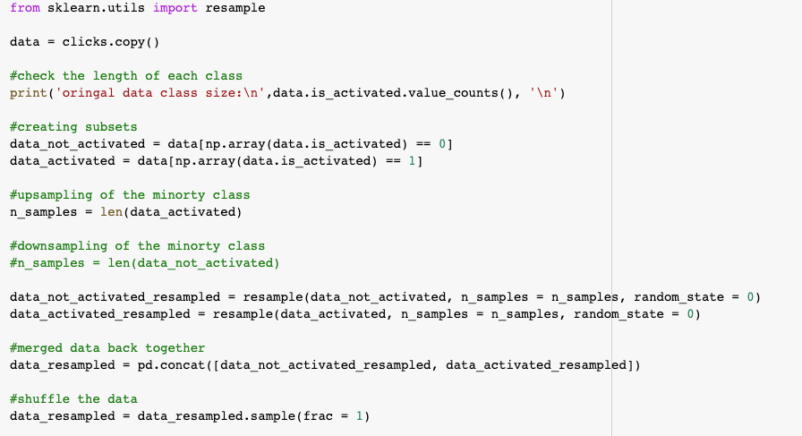
Preprocessing- Imbalanced Classes (Code)

Slide 10
Preprocessing- Incorporating Date/Time
There is date column (created_date) in the dataset that include information about the time of the application. However there are 32 unique values across the entire over 94,000 observations.
I used datetime data represented in two different formats:
1- As a categorical variable: I will later explain how to handle categorical data
2- As a continuous number from 0 to 1 (named as ‘time_index’): First converting to seconds, then scaling between 0 and 1.

Slide 11
Preprocessing- Multi-datatype
As the features include numerical, binary and categorical data we need to make the ready for our model.
To accomplish this, I used the feature_column module from tensorflow and converted all variables either to numerical vectors, multi-dimensional embedded matrices, and crossed hashed data, as follows:
Vectors: for numeric variables: 'in_city', 'is_prime', 'is_hardship', 'time_index'
Categorical matrics: for multicategorical variables: platform', 'category_debt_type'
Embedded matrices: for hyper-categorical variables: 'created_date', 'campaign_state'
Crossed columns: for combination of 'campaign_state' and ‘location_in_query’

Slide 12
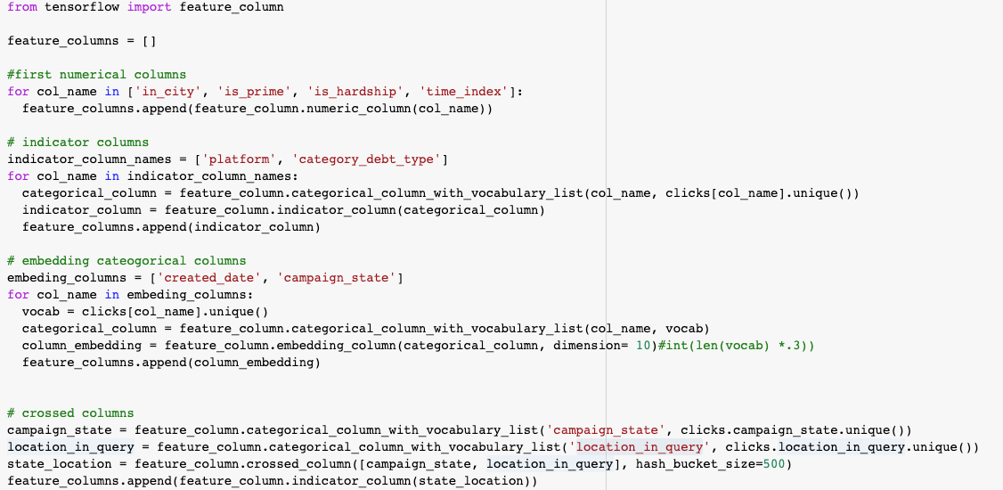
Preprocessing- Multi-datatype (Code)

Slide 13
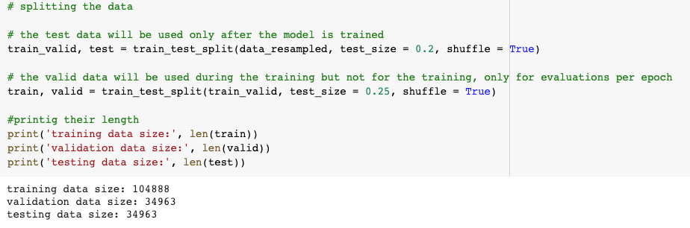
Preprocessing - Train-Validation-Test Split
It is important to split the data into three parts:
Training data: used to train the model
Validation data: used to validate the model on the fly
Test data: used to evaluate the model after it is fitted.

Slide 14
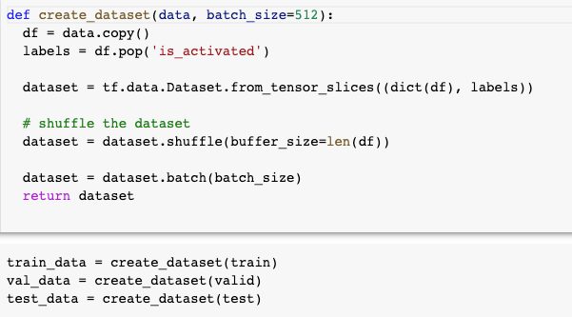
Preprocessing- TensorFlow Ready Datasets
To prepare the input data for the TensorFlow data pipeline, we need to put to in sliced batches of tensors.

Slide 15
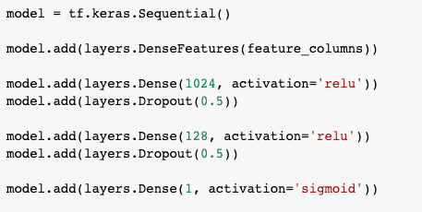
Processing - Model Structure
I used a neural network model with four main layers:
An input layer of all features
A dense layer of 1024 neurons with 50% dropout and ‘ReLU’ activation
A dense layer of 128 neurons with 50% dropout and ‘ReLU’ activation
A final single neuron layer of outputs with ‘sigmoid’ activation

Slide 16
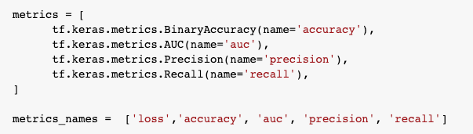
Processing - Model Evaluation
I used four main evaluation metrics to monitor the model performance:
Accuracy: To observe the overall accuracy of the model
AUC: To evaluate the classification of the model
Precision: To evaluate True-Positive vs False-Negative
Recall: To evaluate how the model performed in identifying relevant class.

Slide 17

Processing- Modeling Approach
I used the binary cross entropy function as my loss function that should be optimized.
Because this is a binary classification, the Adam (Adaptive Moment Estimation) optimizer function should perform better than the generic SGD (Stochastic Gradient Descent).
After tuning the 0.001 learning rate showed a reasonable performance

Slide 18
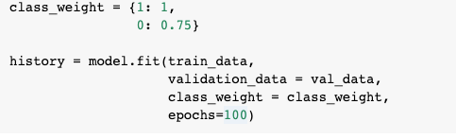
Processing - Model fitting
I used class weights to give more importance to `recall` over precision. This helps the model to start with higher recall and then it converges to higher precision.

Slide 19
Processing - Overfitting
One of the main challenges with ANN models is overfitting. To avoid overfitting, I took several steps:
Carefully monitoring validation convergence: The final model showed great performance on both training and validation data
Applying DropOut layers after large dense layers: I used 50% drop out rate that helped a lot with over-fitting
Using multi-metric evaluation: Instead of just relying on the loss and accuracy values, I also quantified recall, precision and AUC to make sure the model is on the right track.

Slide 20
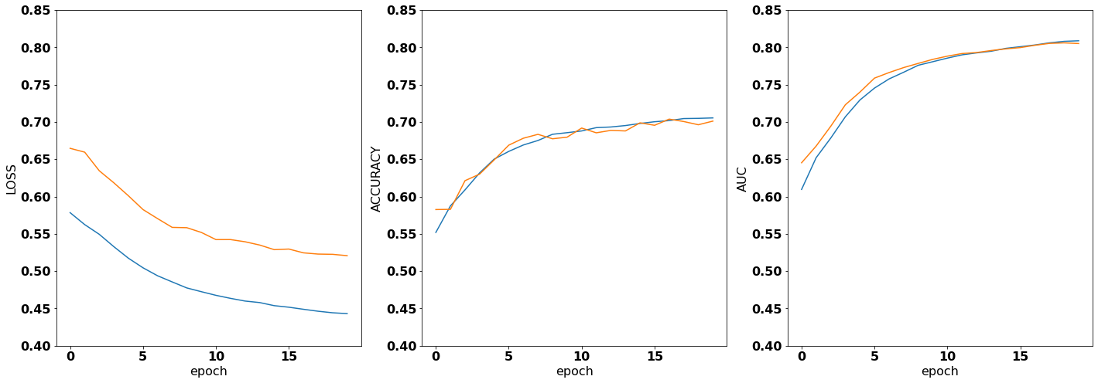
Post-processing: Initial Performance
Only with 20 epochs the tuned model was already on a satisfying trajectory.

Slide 21
Post-processing: Initial Performance
I ran the model for a total of 200 epochs. The model run is relatively fast.
Data | Accuracy | AUC | Recall | Precision
Training
Validation
Test

Slide 22
Engineering Architecture and Trade-Offs:
Question: What does the engineering architecture to productionize one of the solutions looks like? What trade-offs would you use to productionize promising algorithms faster?
Answer:

Slide 23
Business Performance and ROI
Question: Discuss how will you analyze the business performance of the algorithm once in production using metrics such as marketing ROI etc.?
Answer:

Slide 24
Code, Presentation and Repository
Code: The code and a self explanatory Jupyter Notebook is available from here:
https://colab.research.google.com/drive/1le1emKWg3kDgibay0SIrE6v0-VB460UZ?usp=sharing
Presentation: This presentation can be found from the following link:
https://docs.google.com/presentation/d/1bchwCkkt2tYCuIVC7vNqV2exXWL7l7Q15mca6QOwx_8/edit?usp=sharing
Repository: All the data and codes can be found from the following repository:

